Slide 1
WEB CRAWLER
Anshul Toshniwal (RA2011031010081)
Sanskar Bohora(RA2011031010111)
Sanchal Jain(RA2011031010072)
Saundarya Verma(RA2011031010091)

Slide 2
This lecture
Web Crawling

Slide 3
Basic crawler operation
Sec. 20.2
Begin with known “seed” URLs
Fetch and parse them
  Extract URLs they point to
  Place the extracted URLs on a queue
Fetch each URL on the queue and repeat
Breadth First crawling

Slide 4

Crawling picture
Sec. 20.2
URLs crawled
and parsed
Unseen Web
Seed
pages
URLs frontier
Web

Slide 5
Simple picture – complications
Sec. 20.1.1
Web crawling isn’t feasible with one machine
  All of the above steps are usually distributed
Malicious pages
  Spam pages
  Spider traps
Even non-malicious pages pose challenges
  Latency/bandwidth to remote servers vary
  Webmasters’ stipulations
    How “deep” should you crawl a site’s URL hierarchy?
  Site mirrors and duplicate pages
Politeness – don’t hit a server too often

Slide 6
What any crawler must do
Sec. 20.1.1
Be Polite: Respect implicit and explicit politeness considerations
Be Robust: Be immune to spider traps and other malicious behavior from web servers

Slide 7
Explicit and implicit politeness
Sec. 20.2
Explicit politeness: specifications from webmasters on what portions of a site can be crawled
  robots.txt (see next slide)
Implicit politeness: even with no specification, avoid hitting any site too often

Slide 8
Robots.txt
Sec. 20.2.1
Protocol for giving spiders (“robots”) limited access to a website, originally from 1994
  www.robotstxt.org/robotstxt.html
Website announces its request on what can(not) be crawled
  For a server, create a file /robots.txt
  This file specifies access restrictions

Slide 9
What any crawler should do
Sec. 20.1.1
Be capable of distributed operation: designed to run on multiple distributed machines
Be scalable: designed to increase the crawl rate by adding more machines
Performance/efficiency: permit full use of available processing and network resources

Slide 10
What any crawler should do
Sec. 20.1.1
Fetch pages of “higher quality” first
Continuous operation: Continue fetching fresh copies of a previously fetched page
Extensible: Adapt to new data formats, protocols

Slide 11
URL frontier
Sec. 20.2
URLs that have been discovered, but are yet to be crawled
Can include multiple pages from the same host
Must avoid trying to fetch them all at the same time
Must try to keep all crawling threads busy

Slide 12
Processing steps in crawling
Sec. 20.2.1
Which one?
Pick a URL from the frontier
Fetch the document at the URL
Parse the URL
  Extract links from it to other docs (URLs)
Check if URL has content already seen
  If not, add to indexes
For each extracted URL
  Ensure it passes certain URL filter tests
  Check if it is already in the frontier (duplicate URL elimination)
E.g., only crawl .edu, obey robots.txt, etc.

Slide 13
Basic crawl architecture
Sec. 20.2.1
WWW
DNS
Doc
FP’s
robots
filters
URL
set
Parse
Fetch
Content
seen?
URL
filter
Dup
URL
elim
URL Frontier

Slide 14
Parsing: URL normalization
Sec. 20.2.1
When a fetched document is parsed, some of the extracted links are relative URLs
E.g., http://en.wikipedia.org/wiki/Main_Page has a relative link to /wiki/Wikipedia:General_disclaimer which is the same as the absolute URL http://en.wikipedia.org/wiki/Wikipedia:General_disclaimer
During parsing, must normalize (expand) such relative URLs

Slide 15
Content seen?
Sec. 20.2.1
Duplication is widespread on the web
If the page just fetched is already in the index, do not further process it
This is verified using document fingerprints or shingles
  Second part of this lecture

Slide 16
Distributing the crawler
Sec. 20.2.1
Run multiple crawl threads, under different processes – potentially at different nodes
  May be geographically distributed nodes
Partition hosts being crawled into nodes
  Hash used for partition
How do these nodes communicate and share URLs?

Slide 17
Communication between nodes
Sec. 20.2.1
Output of the URL filter at each node is sent to the Dup URL Eliminator of the appropriate node
WWW
DNS
To
other
nodes
URL
set
Parse
Doc
FP’s
robots
filters
Fetch
Content
seen?
URL
filter
Host
splitter
Dup
URL
elim
From
other
nodes
URL Frontier

Slide 18
URL frontier: two main considerations
Sec. 20.2.3
Politeness: do not hit a web server too frequently
Freshness: crawl some pages more often than others
  E.g., pages (such as News sites) whose content changes often
These goals may conflict with each other.
(E.g., simple priority queue fails – many links out of a page go to its own site, creating a burst of accesses to that site.)

Slide 19
Politeness – challenges
Sec. 20.2.3
Even if we restrict only one thread to fetch from a host, can hit it repeatedly
Common heuristic: insert time gap between successive requests to a host that is >> time for most recent fetch from that host

Slide 20
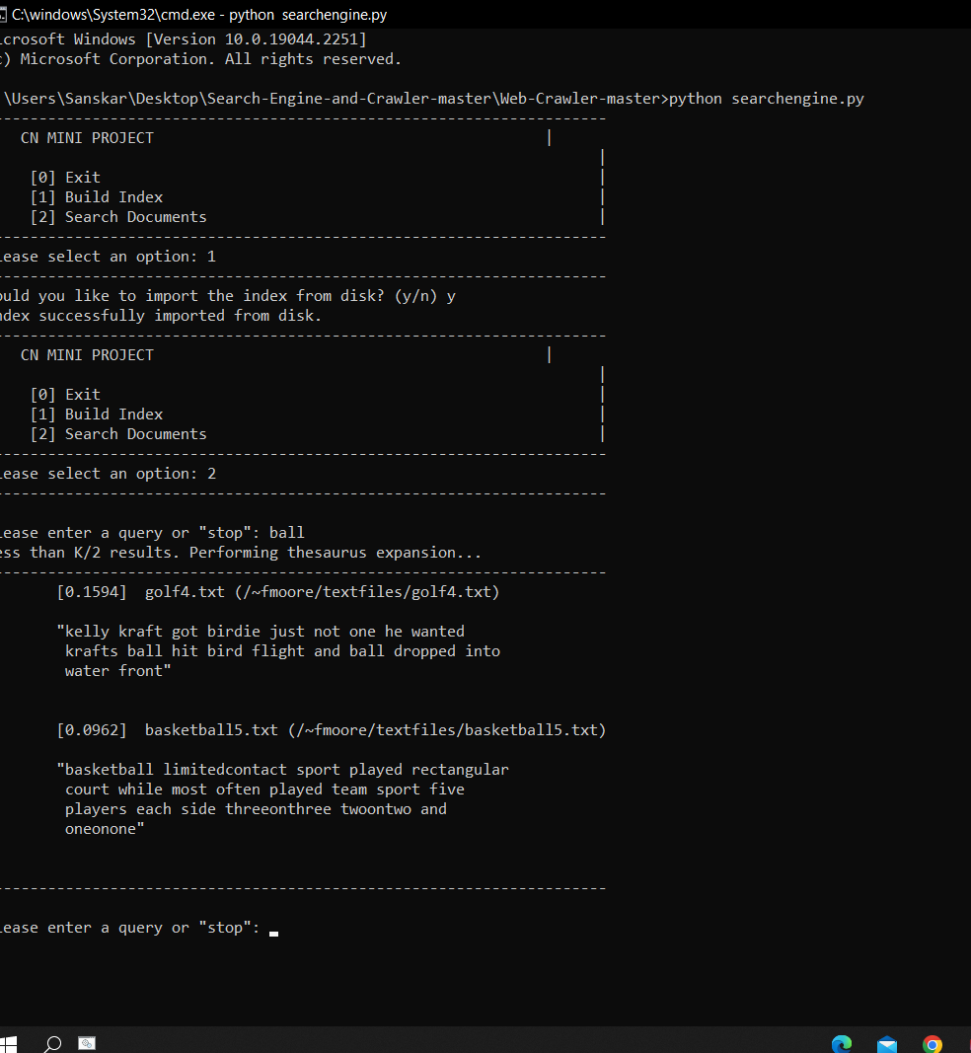
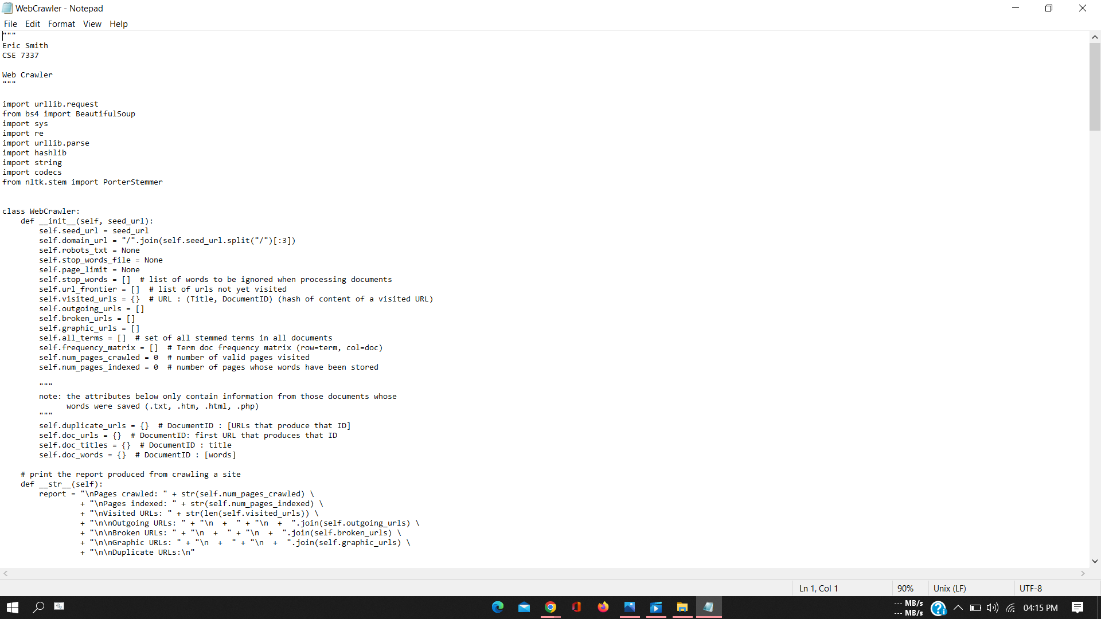
IMPLEMENTATION AND SOURCE CODE

Slide 21
THANK YOU

